Slide 1
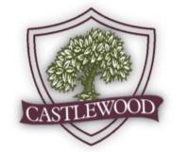

The Annual Meeting of the Membership will be held on December 10, 2024, at 6:00 pm in the Clubhouse. If you are unable to attend in person, be sure o return your absentee ballot/ proxy no later than December 6, 2024.
Castlewood Connection
December 2024
Community Manager
Jennifer Hansen
jhansen@spectrumam.com
Onsite Office Administrator
Terri Bustillos
tbustillos@spectrumam.com
Office Hours- Monday, Tuesday, & Wednesday
10:00 am to 3:00 pm
Onsite phone- 972-317-2457
www.castlewoodhoa.com
www.spectrumam.com
Notes:
1

Slide 2
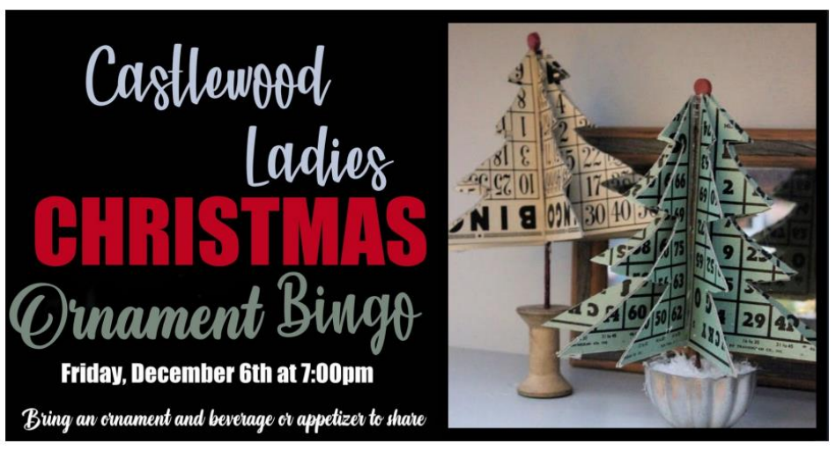
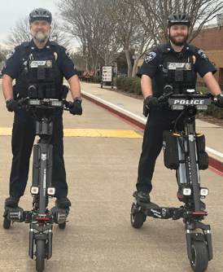

Slide 3
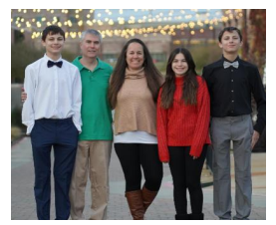
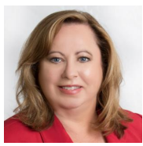
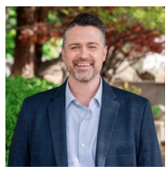
Meet the Candidates
Amber Coddington- current treasurer and candidate for the Board of Directors
Amber Coddington is no stranger to most of you. Amber is very involved in a variety of clubs and groups in the community and has a busy family of six. Amber is the proud mom to Ashley, Trevor, Caleb, and Hannah. Not only is she involved with a wide variety of activities right here in Castlewood, but she also runs National Computer with her husband Gerald. Amber holds a bachelor’s degree in political science and a master’s degree in early childhood education. Amber serves in several roles in various organizations including the Castlewood Dragons Swim Team, Briarhill Band and Orchestra booster clubs, Marcus Band & Orchestra, and Girl Scouts. She is also an administrator for the Castlewood Moms Facebook group. Amber has served on the Castlewood BOD as the treasurer for the past ten years. It is clear she is dedicated to the success of the community and the objectives of the HOA and will continue to work to keep Castlewood a great place to live.
Melody Orrantia– current secretary and candidate for the Board of Directors
Melody is a Castlewood resident since 2000 and has served the past two years as Secretary of the Castlewood HOA Board of Directors. She and her husband Dan raised their daughter Hayley in Castlewood. Hayley is best known for playing the role of “Erica Goldberg” for 10 years on ABC Television's The Goldbergs and is an accomplished singer/songwriter. Melody has been a realtor for the past 8 years and has represented many Castlewood owners in the sale of their home. Along with her sister, Melody also owns Grand Fiori which handcrafts and rents giant standing flowers for weddings, parties and special events. Prior to becoming a realtor, Melody spent many years as an executive at one of the world’s largest management consulting firms, Accenture, where she provided strategy consulting to several Fortune 100 companies. Throughout her career, she has served in a leadership capacity in several nonprofit organizations including the United Way and the Network of Executive Women.
Cameron Glass- candidate for the Board of Directors- Current Modifications Committee Member
Since moving to Castlewood in May 2023, Cameron Glass quickly got involved in serving the neighborhood through his work on the Architecture Committee. Over the past year, he worked with the committee to update and present the community’s revised design guidelines. Cameron and his wife, Megan, are raising their four children—Aidyn, Peyton, Owen, and Ellison— and have enjoyed taking part in the neighborhood’s activities and events. Cameron Glass holds a leadership position at a prominent construction management firm, where he oversees large-scale, complex projects. His work focuses on strategic leadership, fostering collaboration, and supporting community development. With extensive experience managing multi-million-dollar initiatives, Cameron ensures projects are completed on time, within budget, and to the satisfaction of diverse stakeholders. His 24-year career in management has equipped him with the skills necessary to address community needs with efficiency and foresight. In addition to his professional background, Cameron is passionate about giving back and helping to shape Castlewood’s future. His goal as a board member is to maintain and enhance the sense of community that makes Castlewood a sought-after community to live in, while addressing concerns related to our community's infrastructure, development, and neighborhood engagement.

Slide 4

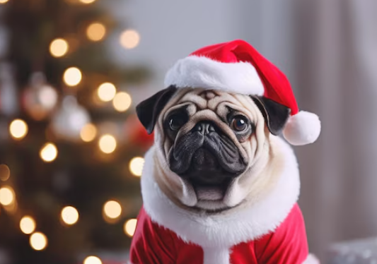
2025 Assessments
2025 Assessments will remain $650 for the 15th consecutive year!
Payments can be made by logging into your Spectrum account, over the phone, or by mail. Payment is not accepted in the onsite office.
Wishing you a merry holiday season!
The Castlewood Board of Directors
The Modifications Committee
The Social Committee
Jennifer & Terri and the Spectrum Association Management Team

Slide 5
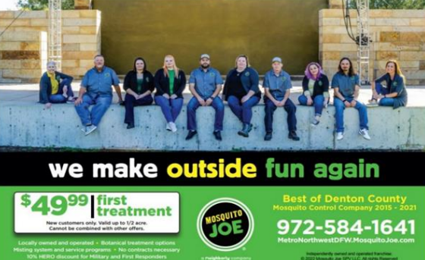
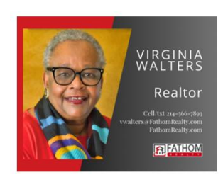



Community Sponsors

